Slide 1
Grid walk
Andres Felipe Vargas

Slide 2
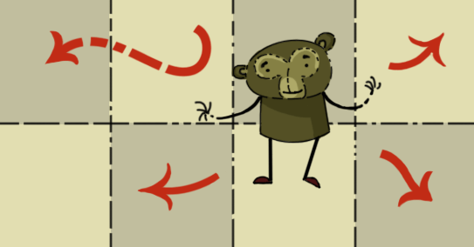
Problem description
There is a monkey which can walk around on a planar grid. The monkey can move one space at a time left, right, up or down. That is, from (x, y) the monkey can go to (x+1, y), (x-1, y), (x, y+1), and (x, y-1).
Points where the sum of the digits of the absolute value of the x coordinate plus the sum of the digits of the absolute value of the y coordinate are lesser than or equal to 19 are accessible to the monkey.
How many points can the monkey access if it starts at (0, 0), including (0, 0) itself?

Slide 3
Problem Analysis
What is the maximum distance that the monkey can travel in a straight line?
Greatest distance traveled will be along the axis (x or y)
Going down the x-axis
(0,99) sum = 0 + 9 + 9 = 18
(0,199) sum = 0 + 1 + 9 + 9 = 19
(0,299) sum = 0 + 2 + 9 + 9 = 20
(0,298) sum = 0 + 9 + 9 = 19
So, maximum distance traveled in a straight line will be 298 grids

Slide 4
How does the grid look like?
The initial grid that the monkey will be in will be 597x597.
597
597

Slide 5
How does the grid look like?
The initial grid that the monkey will be in will be 597x597.
This grid can also be broken down into 4, identical, quadrant. Each quadrant being 299x299
The quadrants will have some overlapping grids
299
597
299
597

Slide 6
Modifying the grid
The grid can be modified to get 4 equal rectangles. As shown in the image to the right.
Therefore, to get the total of visited grids, only one rectangle needs to be calculated.
This cuts the work needed to be done by 4!
299
597
298
597

Slide 7
Inspecting the quadrant
We will round the quadrant to be a 300x300.
The quadrant can then be split into 9 even blocks, all having a width and height of 100 grids.
300
100
100
300

Slide 8
Inspecting the quadrant
298
If we focus on the x direction, as mentioned earlier, the longest distance that can be travelled is 298.
300
300

Slide 9
Inspecting the quadrant
297
If we travel down in the x direction by +1, staying in the x axis, the longest distance traveled would be (1, 297).
Sum of (1,297) = 1 + 2 + 9 + 7 = 19
300
300

Slide 10
Inspecting the quadrant
296
If we travel down in the x direction by +1 again, the longest distance traveled would be (2, 296).
Sum of (2,296) = 2 + 2 + 9 + 6 = 19
300
300

Slide 11
Inspecting the quadrant
This pattern continues all the way until x = 298.
300
300

Slide 12
Inspecting the quadrant
This pattern continues all the way until x = 298.
This means that the outer layers that the monkey will visit will create a triangle shape outline.
This shows that only 6 of the 9 blocks will ever be visited by the monkey.
300
300

Slide 13
Inspecting the quadrant
This pattern continues all the way until x = 298.
This means that the outer layers that the monkey will visit will create a triangle shape outline.
This shows that only 6 of the 9 blocks will ever be visited by the monkey.
300
300

Slide 14
Inspecting the blocks
3
The examine blocks also show pattern within each other.
Each block is a triangle within as well.
This means that the max height of the block will dictate the grids visited.
2
5
300
1
4
6
300

Slide 15
Inspecting the blocks
3
The examine blocks also show pattern within each other.
We can see these patters by examining the maximum height reached within the individual blocks.
Block 1 reaches it maximum height twice at 99
(0,99): sum = 18
(1,99): sum = 19
2
5
300
1
4
6
300

Slide 16
Inspecting the blocks
3
The examine blocks also show pattern within each other.
We can see these patters by examining the maximum height reached within the individual blocks.
Block 2 reaches it maximum height at 199, which is 99 from the start of block 2
(0,199): sum = 19
2
5
300
99, 99
1
4
6
300

Slide 17
Inspecting the blocks
3
The examine blocks also show pattern within each other.
We can see these patters by examining the maximum height reached within the individual blocks.
Block 3 reaches it maximum height at 298, which is 98 from the start of block 3
(0,298): sum = 19
99
2
5
300
99, 99
1
4
6
300

Slide 18
Inspecting the blocks
98
3
The examine blocks also show pattern within each other.
We can see these patters by examining the maximum height reached within the individual blocks.
Block 4 reaches it maximum height at 99
(100,99): sum = 19
99
2
5
300
99, 99
1
4
6
300

Slide 19
Inspecting the blocks
98
3
The examine blocks also show pattern within each other.
We can see these patters by examining the maximum height reached within the individual blocks.
Block 5 reaches it maximum height at 198, which is 98 from the start of block 5
(100,198): sum = 19
99
98
2
5
300
99, 99
99
1
4
6
300

Slide 20
Inspecting the blocks
98
3
The examine blocks also show pattern within each other.
We can see these patters by examining the maximum height reached within the individual blocks.
Block 6 reaches it maximum height at 98
(200,98): sum = 19
99
98
2
5
300
99, 99
99
1
4
6
300

Slide 21
Inspecting the blocks
98
3
Inspecting the blocks shows a pattern between the blocks visited.
We can see that block 2 and 4 are the same. And block 3, 5, and 6 are the same.
So, only 3 blocks need to be calculated.
This cuts the quadrant calculations in half!
99
98
2
5
300
99, 99
99
98
1
4
6
300

Slide 22
Cases
98
3
The geometry of the problem results in the calculation of only 3 grids.
Case 1
Calculating the number of grids visited in block 1
Case 2
Calculating the number of grids visited in block 2
Case 3
Calculating the number of grids visited in block 3
99
98
2
5
99, 99
99
98
1
4
6

Slide 23
Results
3
Calculate the 3 cases.
Subtract 298 from the result
Multiply by 4
Add 1
2
5
1
4
6
597
597

Slide 24
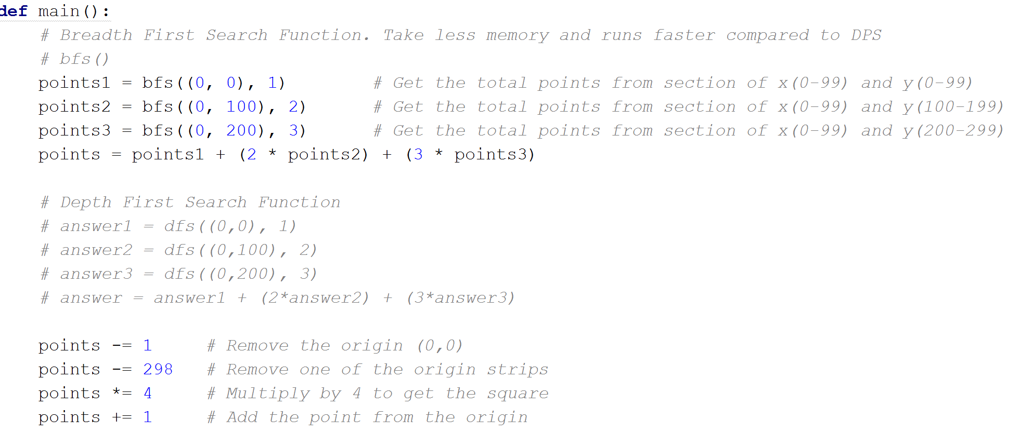
Code

Slide 25
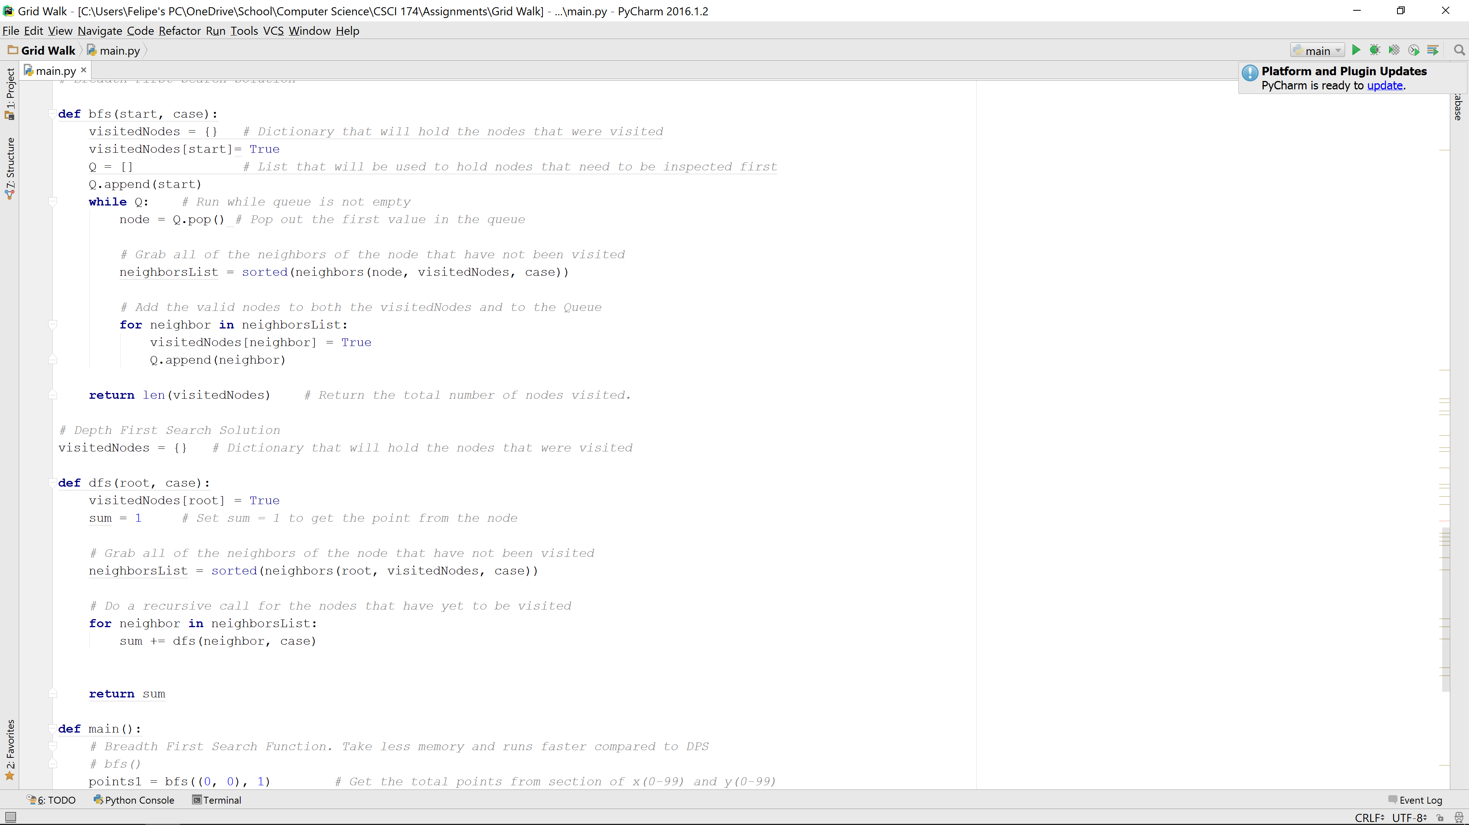
Code

Slide 26
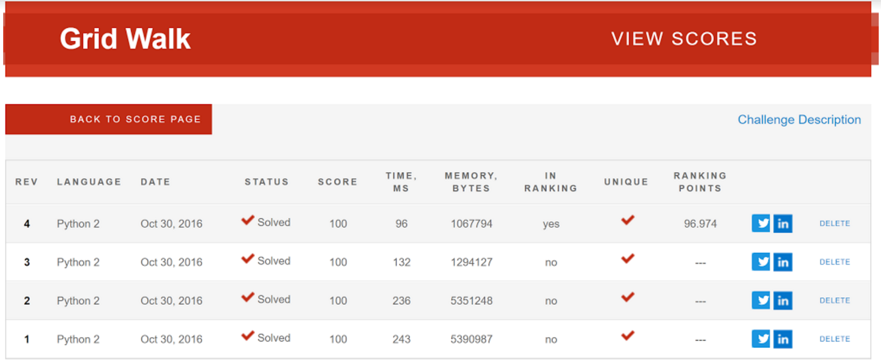
CodeEval

Slide 27
Thank you
Questions?

